Slide 1
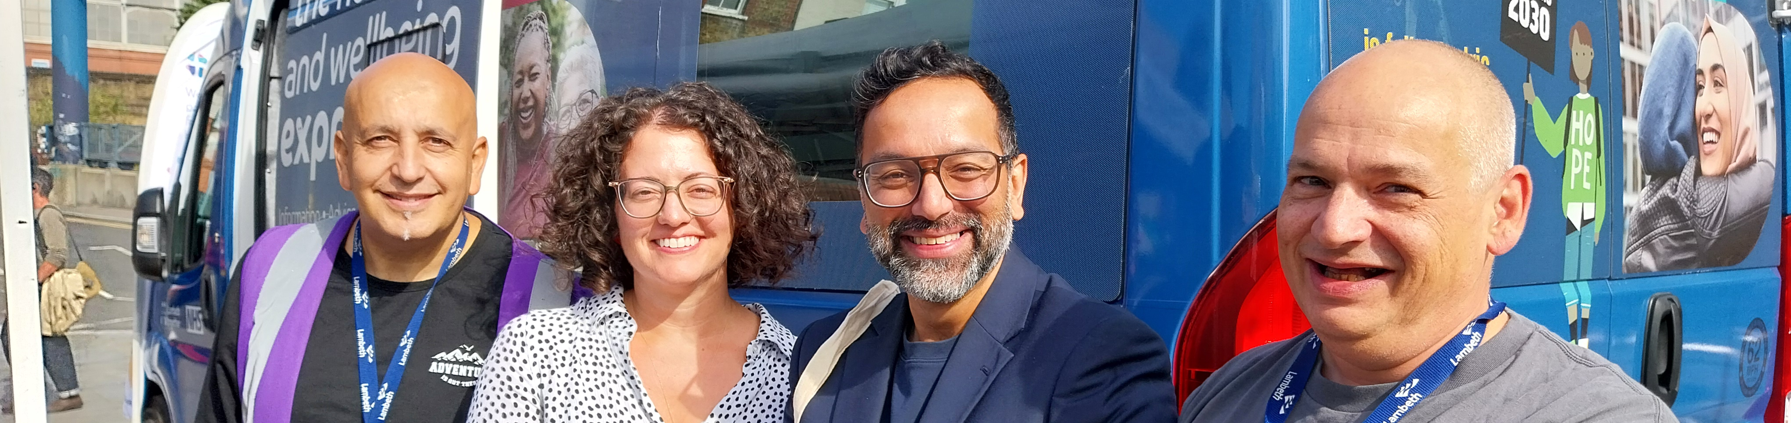
Board on the Bus
Listening in our Communities

Slide 2
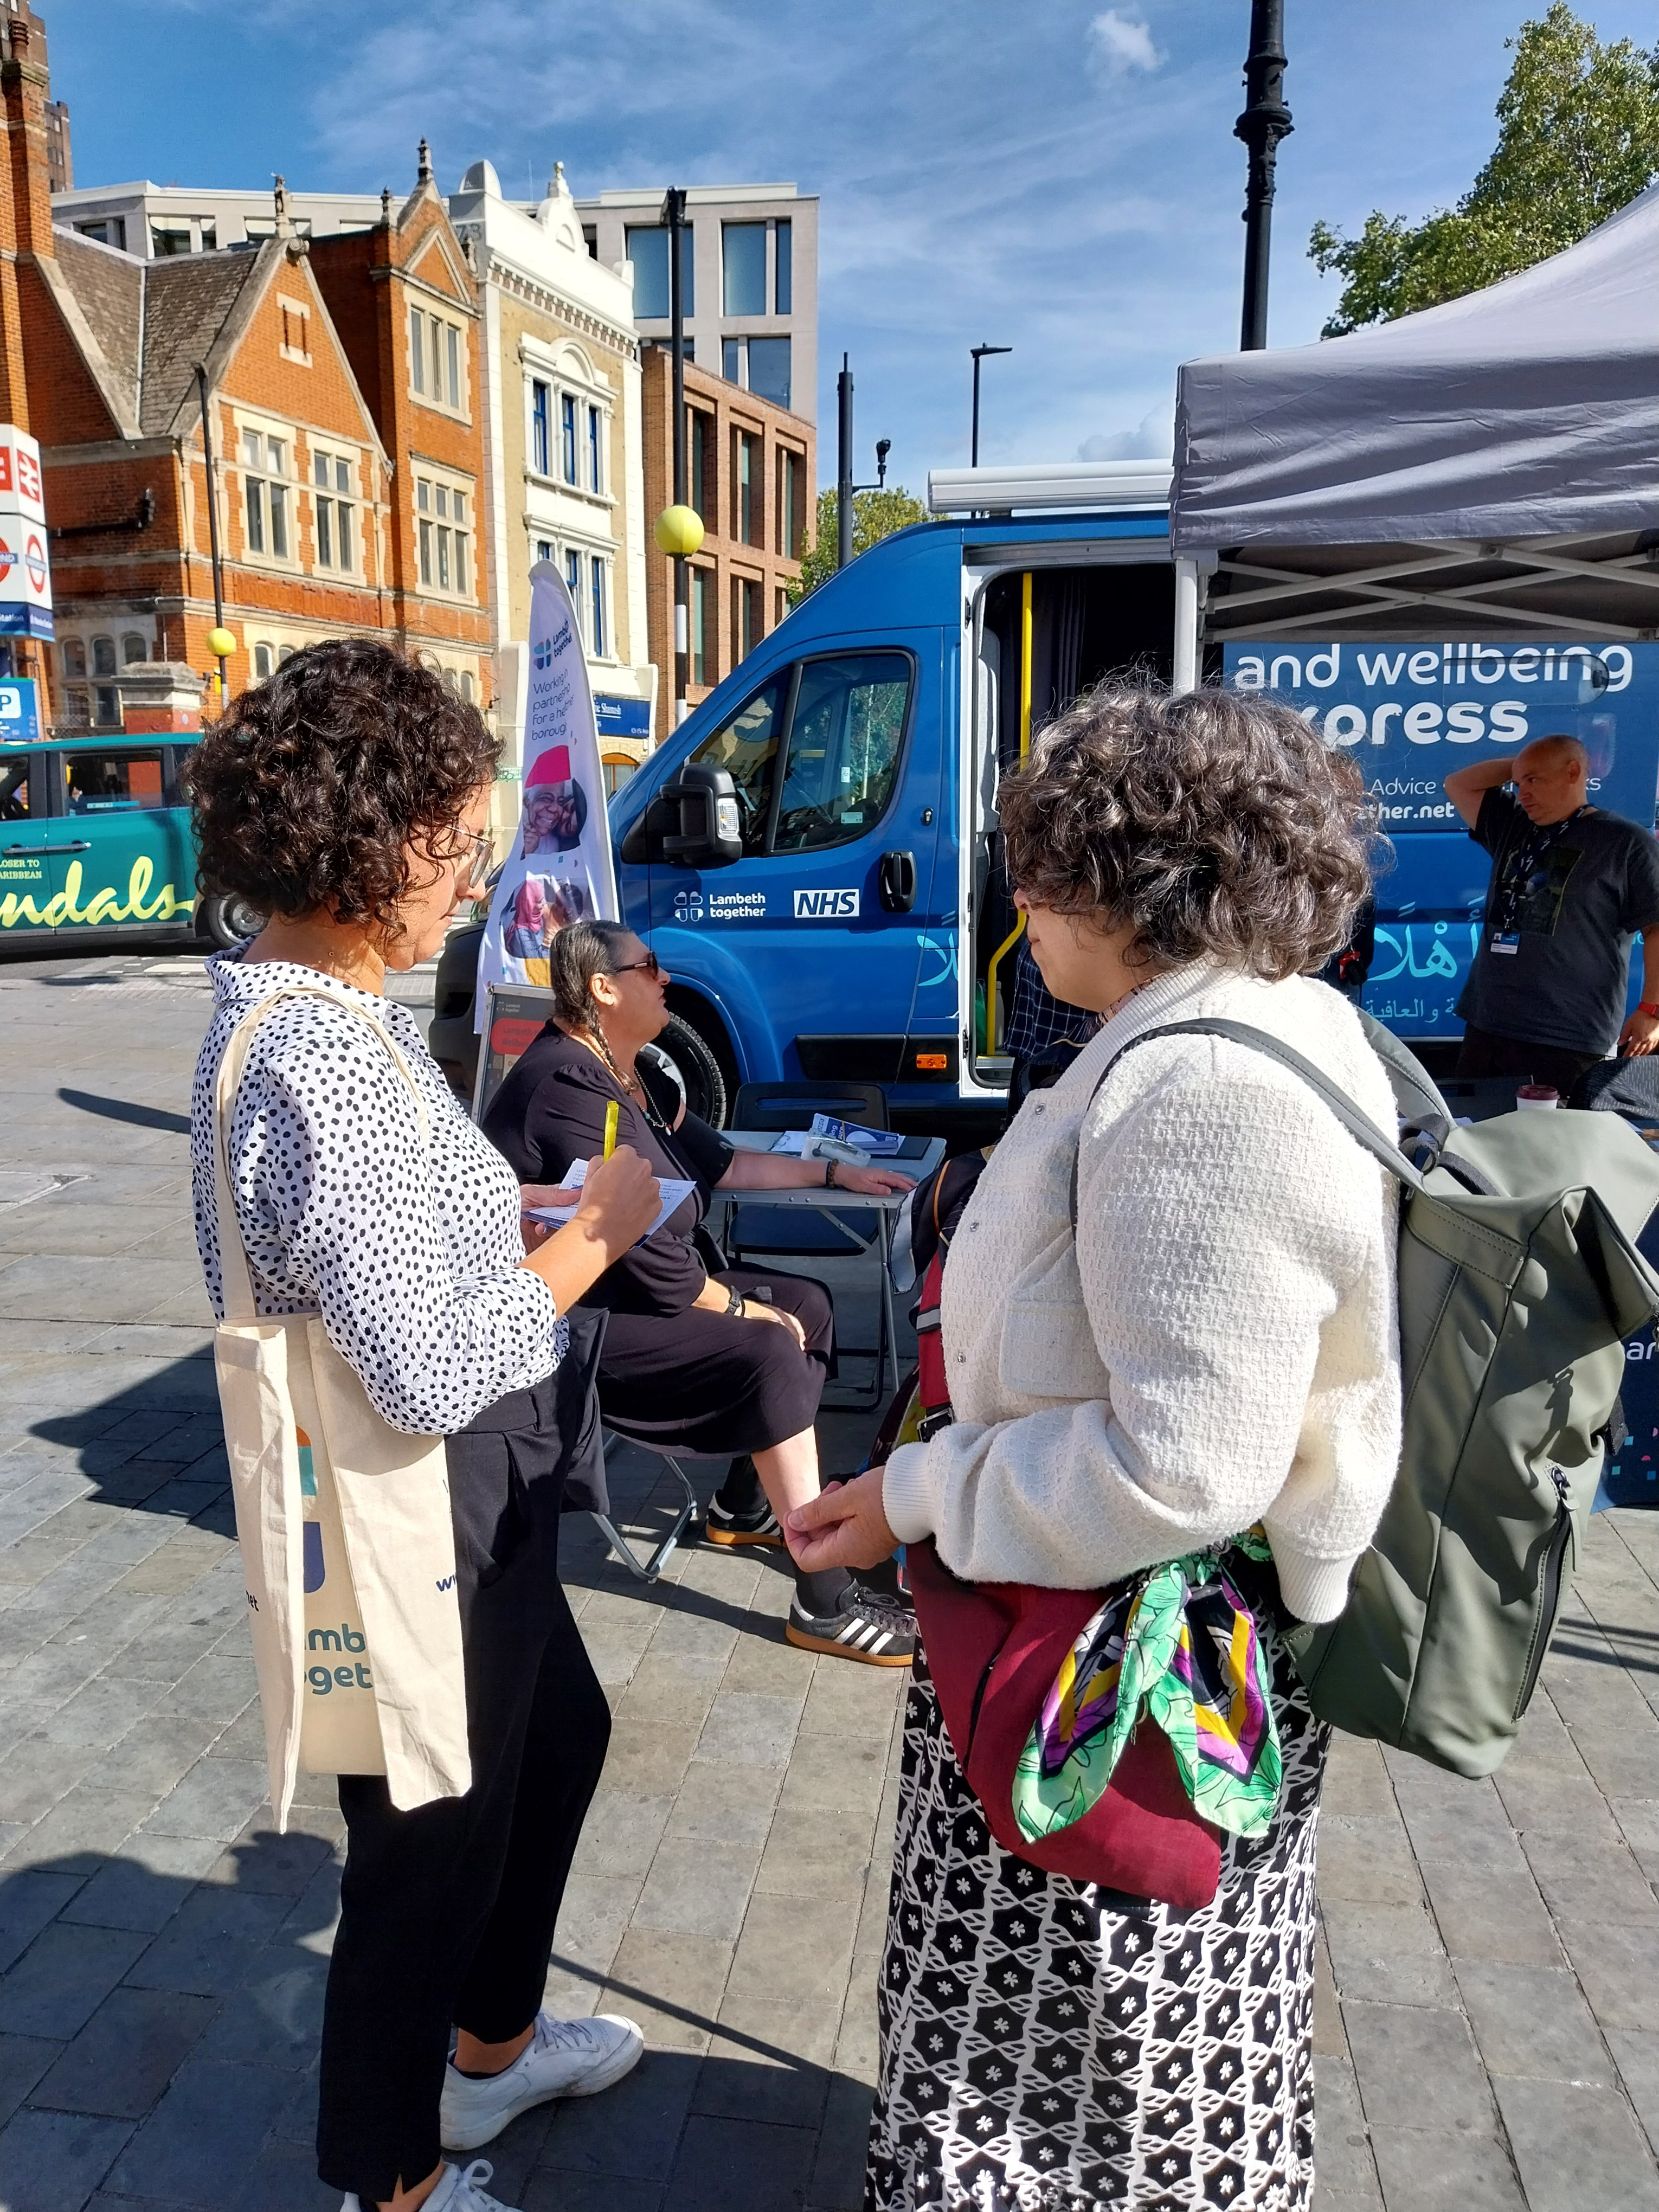
  Board on the Bus: out in the community in September at Lower Marsh Market – 10 September 2026
  Dr George Verghese, GP and Chair of the Lambeth GP Provider Alliance, Anna Marcus, Associate Director of Primary and Community Care and Richard Davis, Volunteering Lead Lambeth Council
Spoke with 8 residents
Themes from ‘what matters to you’ postcards:
  Access to GP appointments, healthcare and advice
  More advice on keeping a healthy weight and improve diet
  Advice on avoiding or reducing alcohol intake
  More access to complimentary therapies e.g. yoga, reflexology
  More access to mental health support to keep happy and independent
  Many mentions of prevention and support to keep well before illness
  or crisis occurs
  Richard updated the team on routes into volunteering and was on
  hand to answer residents queries.

