Slide 1
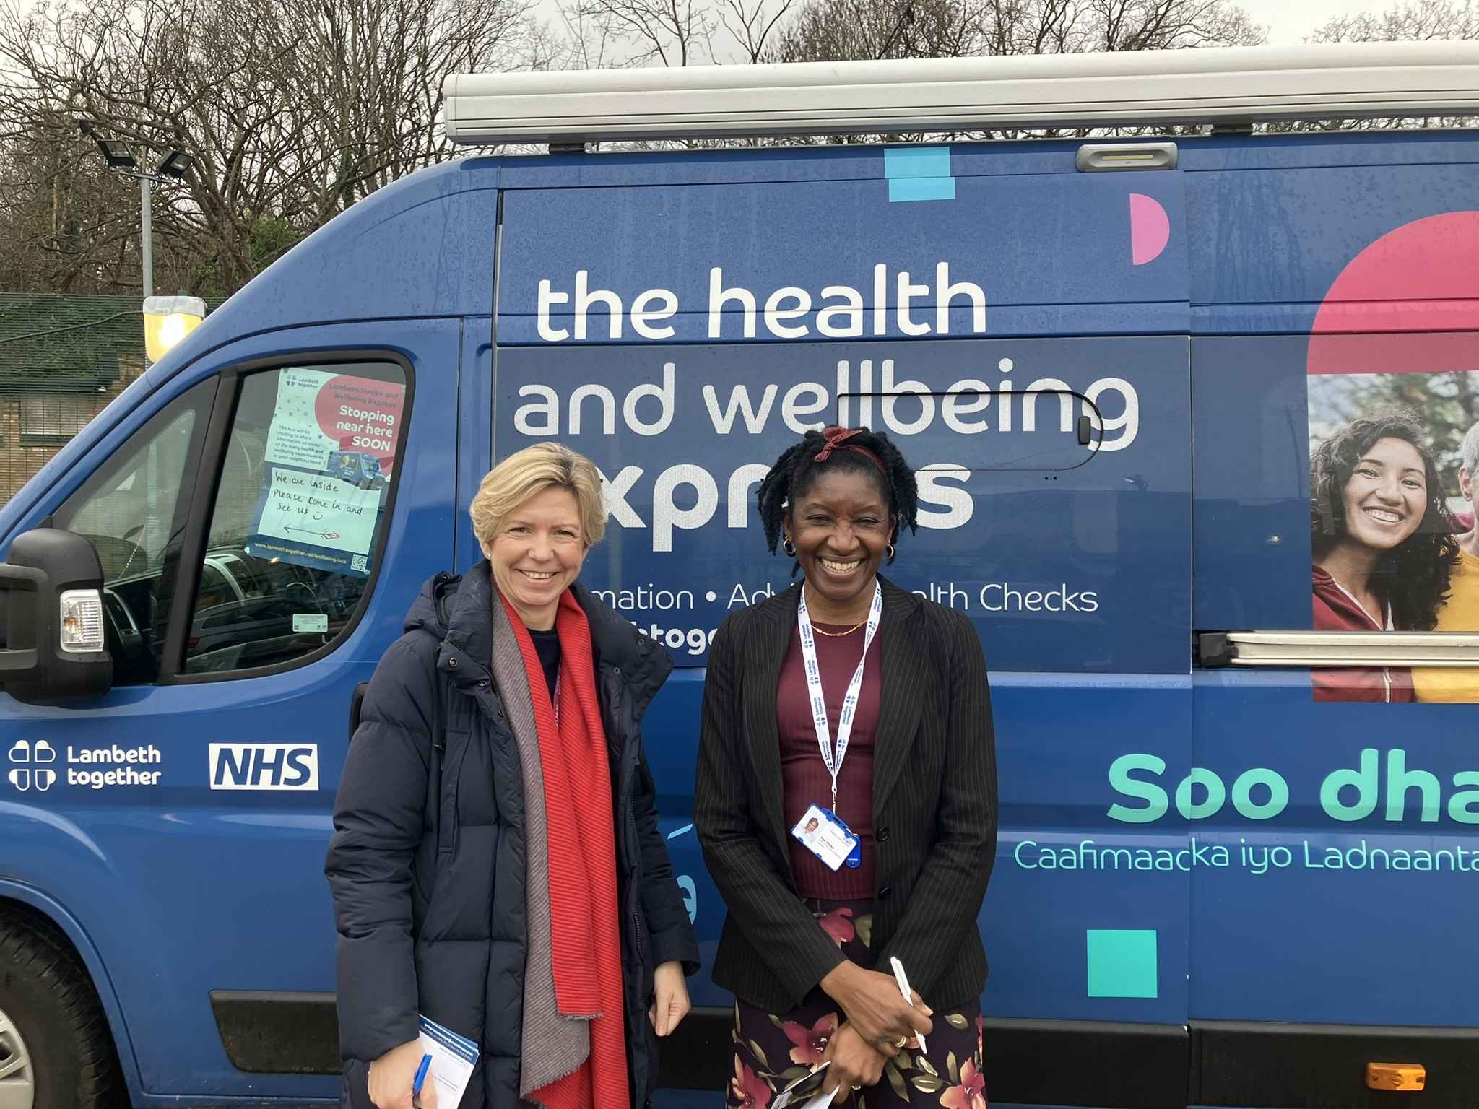
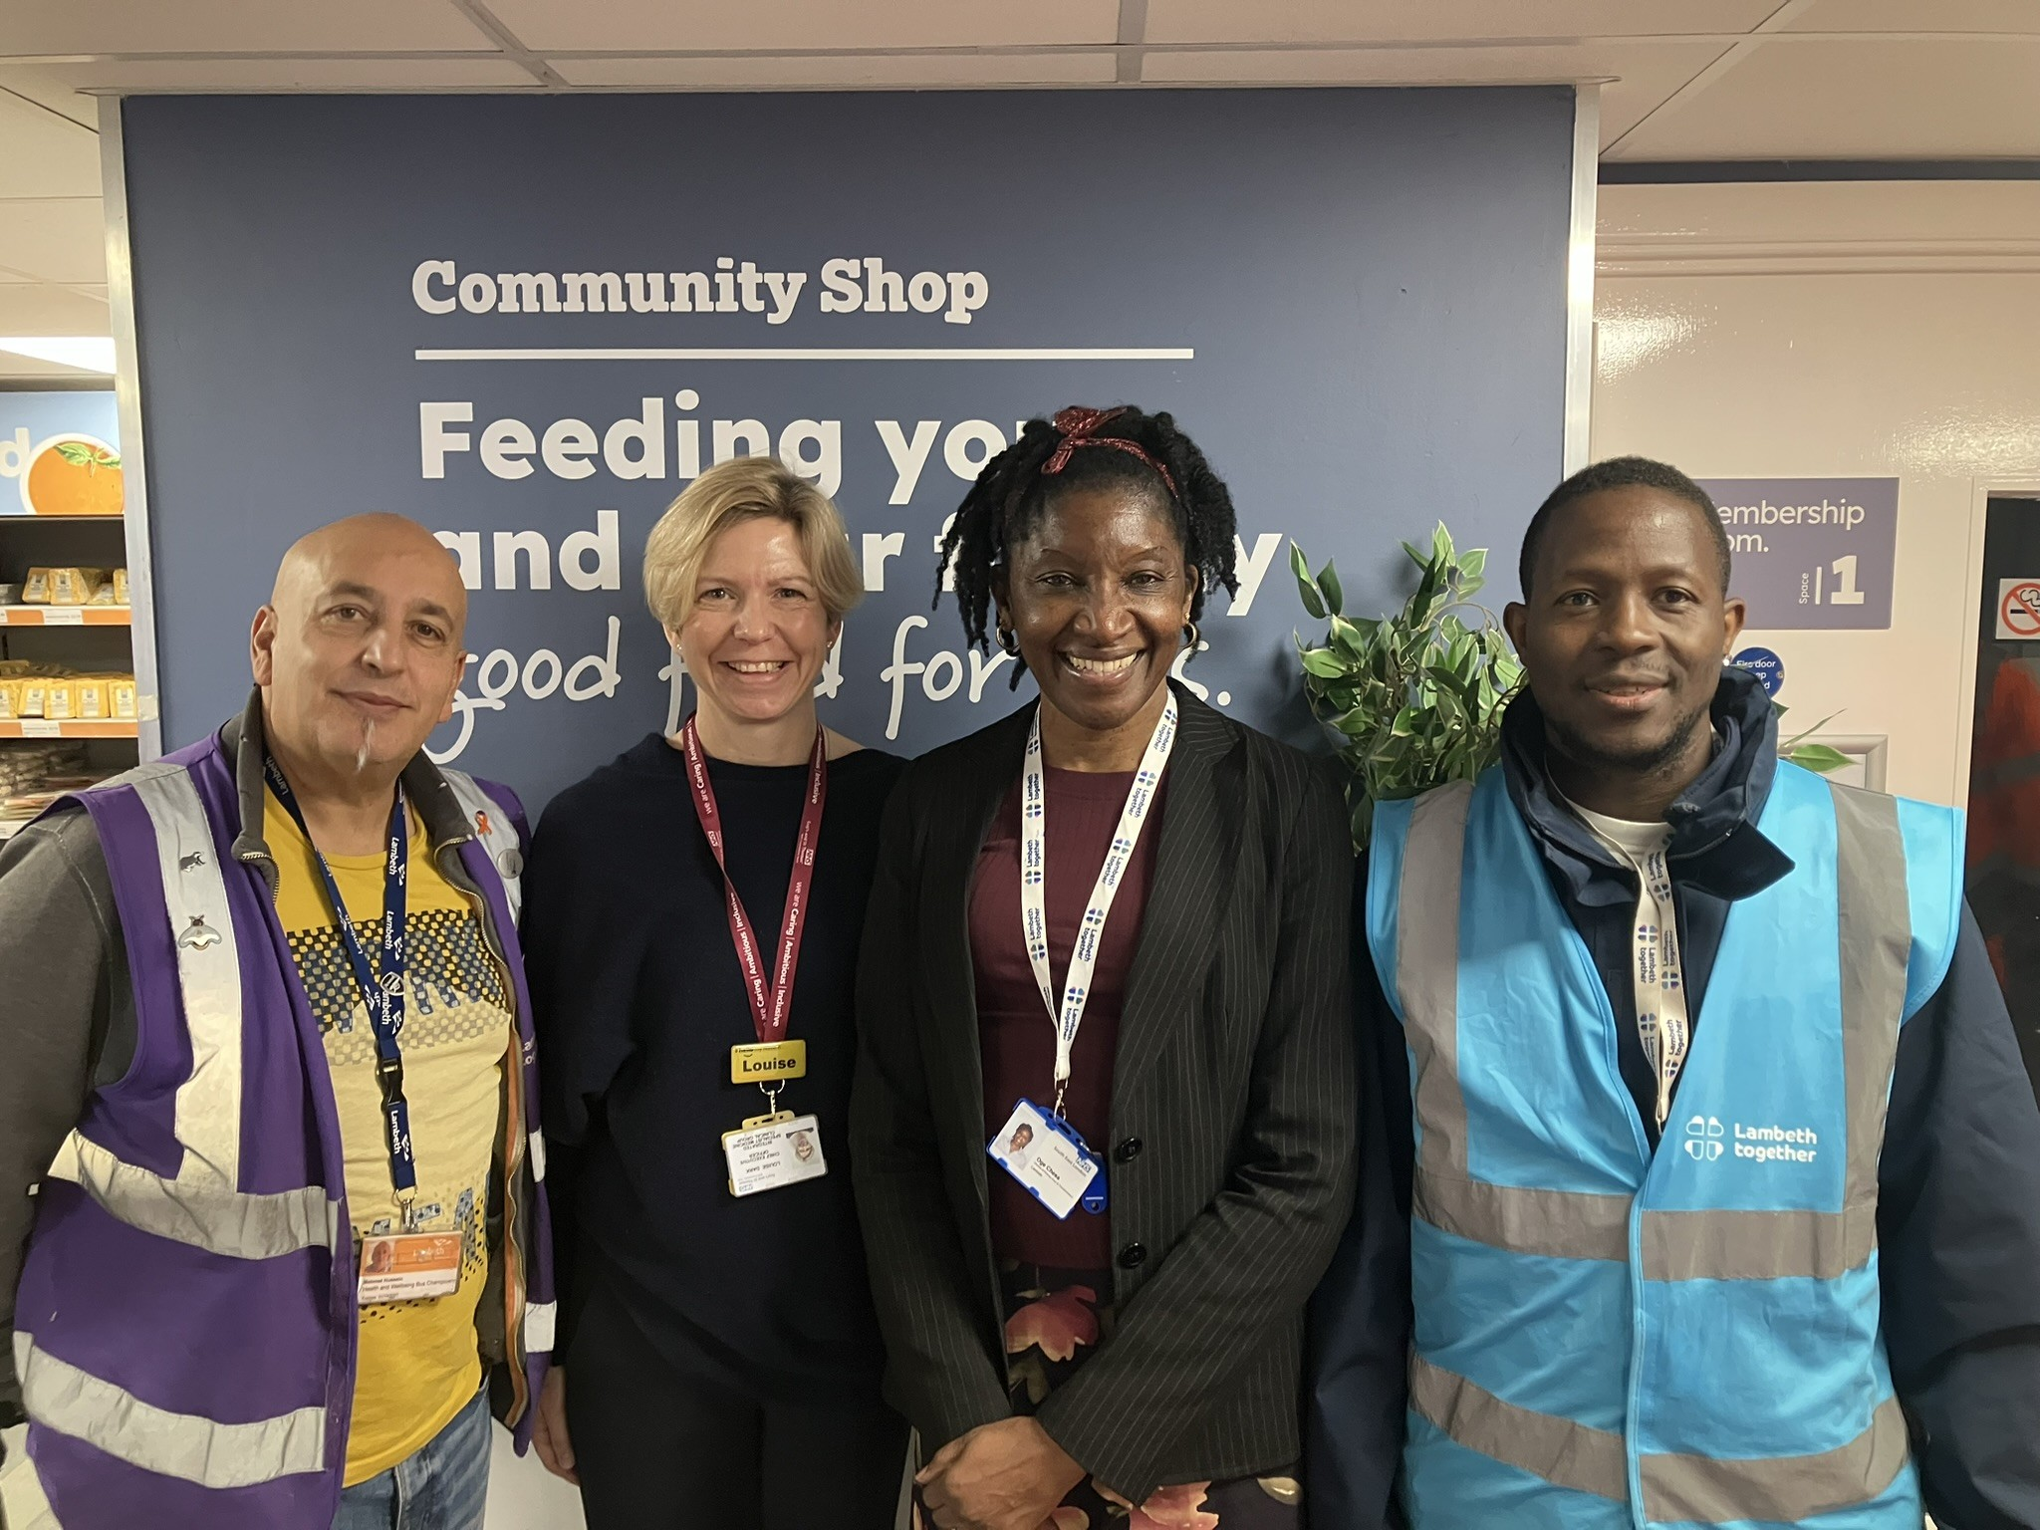
Board on the Bus
Listening in our Communities

Slide 2
Board on the Bus: out in the community in January at The Community Shop, Norwood, 12 January 2026
Louise Dark, Chief Executive, Specialist and Integrated Medicine GSTT, Oge Chesa, Director of Primary Care and Transformation, SEL ICB Lambeth
Spoke with 31 residents:
Themes and requests from ‘what matters to you’ postcards:
Access to GP/A&E/dentist/optician(15), information on food/nutrition (6), better access to mental health services needed (5), advice and access to exercise /leisure activities (4), concerns about housing (4), regular access to health checks (3), good listening from health and wellbeing staff (3), community activities/cohesion (3), concerns around cost of living (3), NHS funding (2), children’s health/childcare, support for learning disabilities

