Slide 1
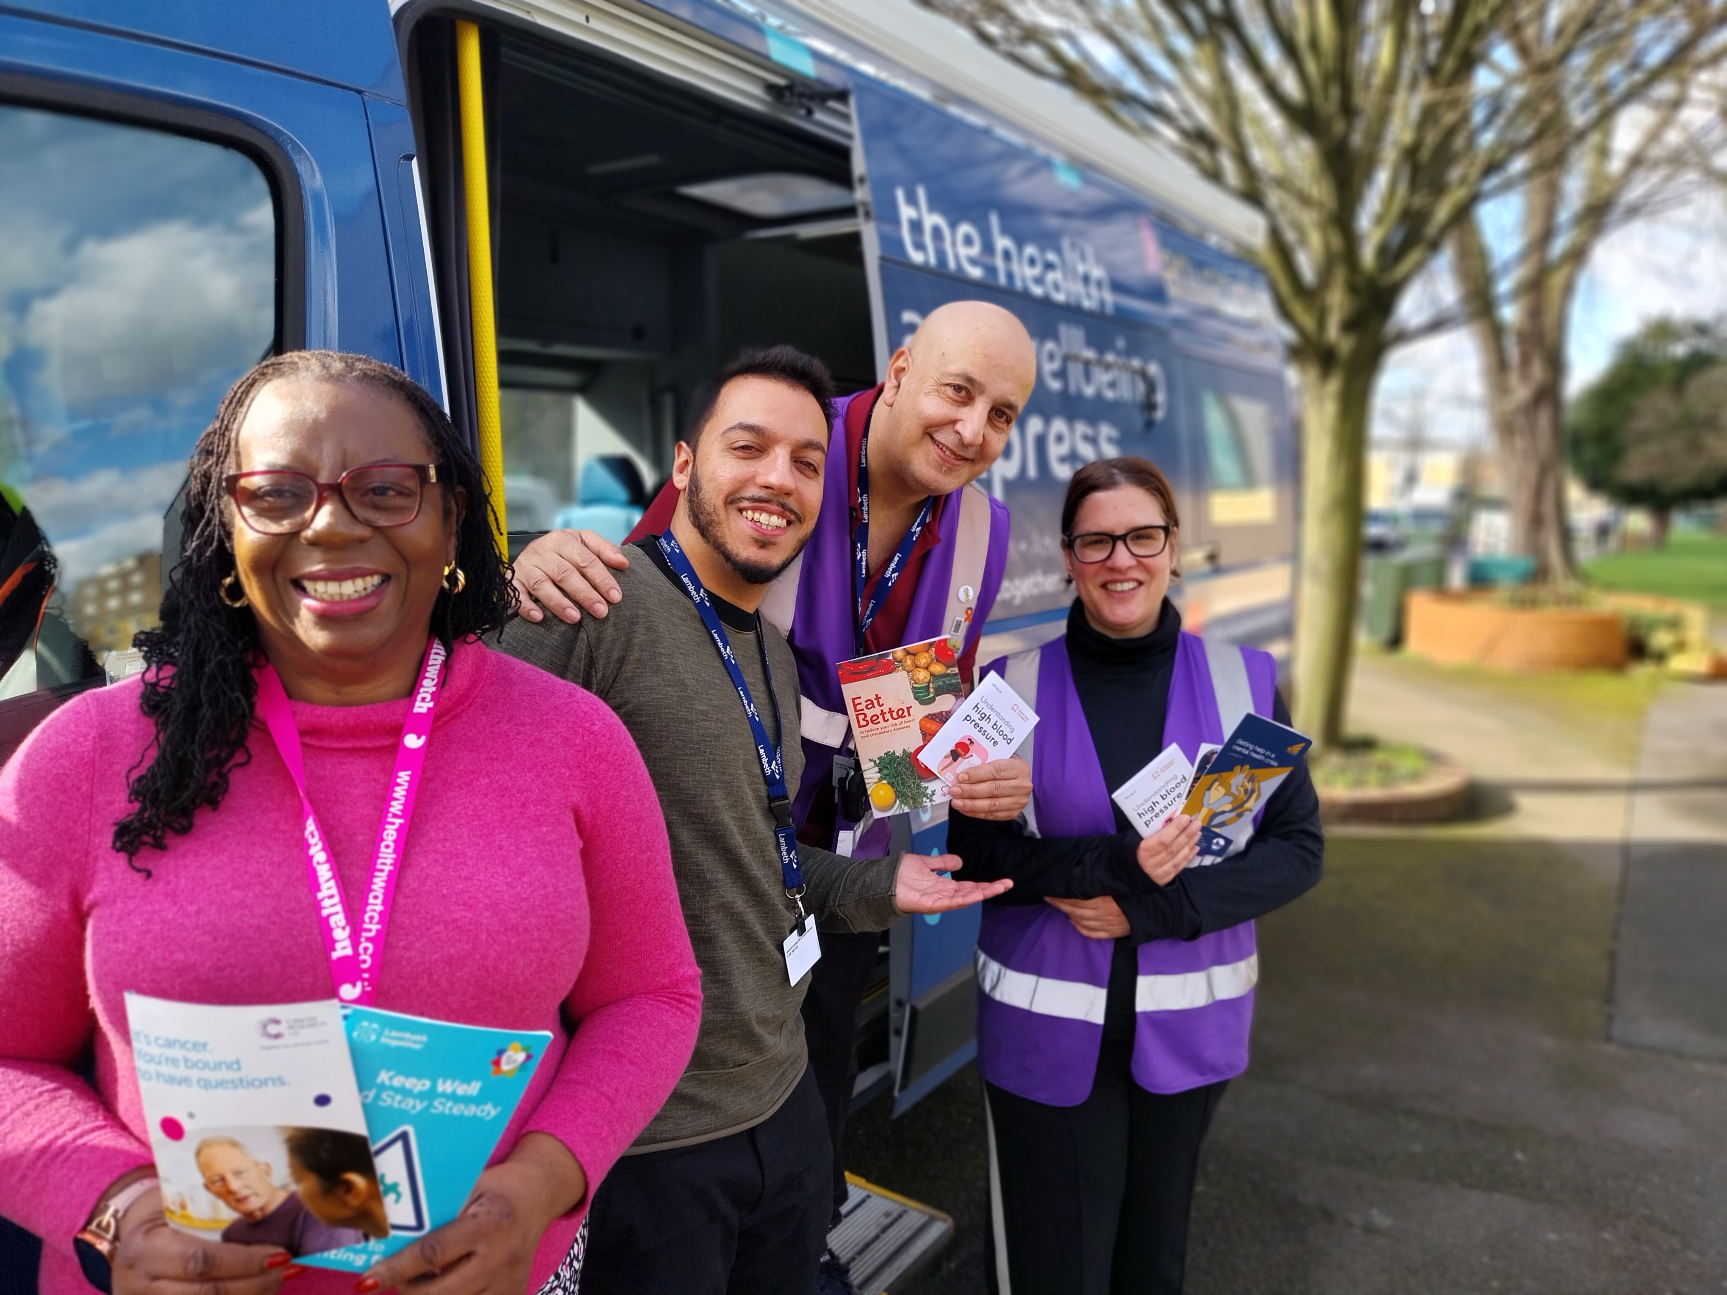
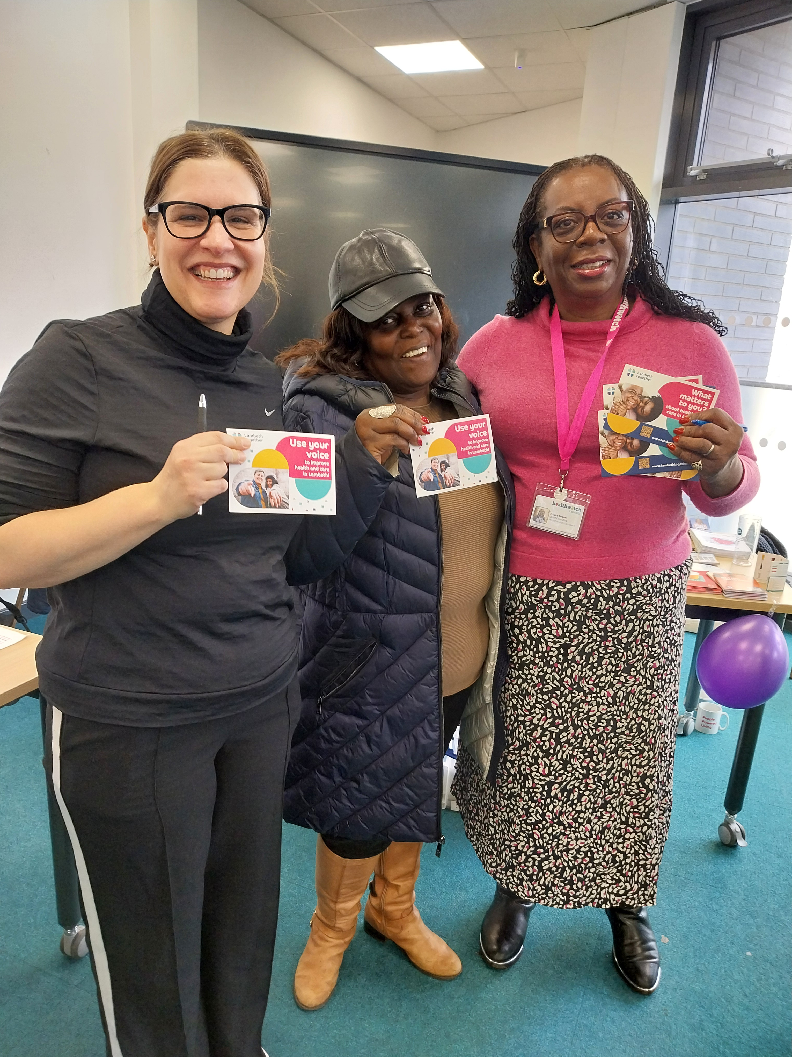
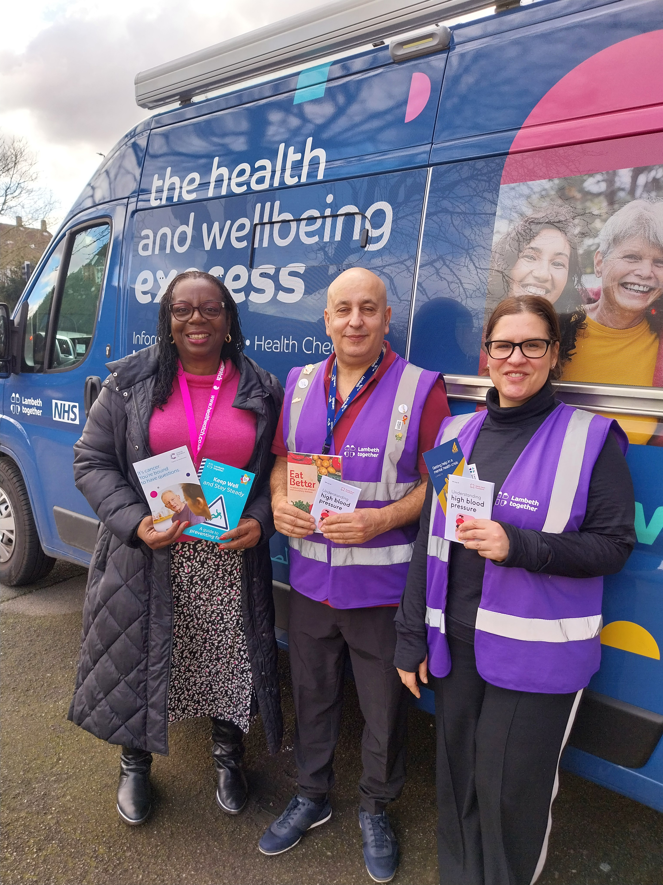
Board on the Bus Listening in our Communities

Slide 2
Board on the Bus: out in the community in February at Clapham Park Cube – Cancer Awareness Event – 27 Feb 2024 Folake Segun, CEO Healthwatch Lambeth and Jasmina Lijesevic, Lay Member, Lambeth Together Care Partnership Board - Regular stop for the bus at Clapham Park Cube Community Centre - Blood pressure checks offered, information on cancer screening
Spoke with 6 residents
Themes from ‘what matters to you’ postcards:
Housing – one resident has been on the housing list for 18 years, wishes to stay in Lambeth to stay with ‘excellent supportive’ GP.
Wishing to feel heard and cared for “I feel ignored and not cared for”
Better listening
Tips for better sleep
More regular BP checks
Controlling diabetes
Better pain management for older people
Some positive comments about caring GPs

