Slide 1
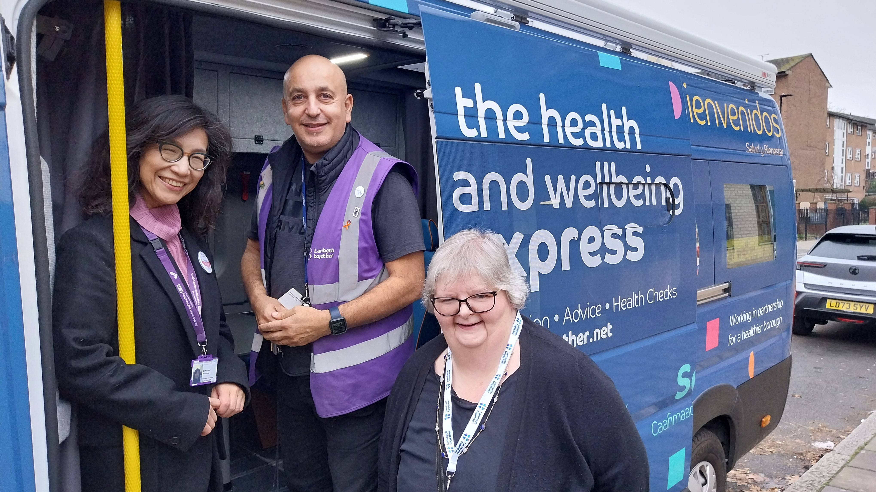
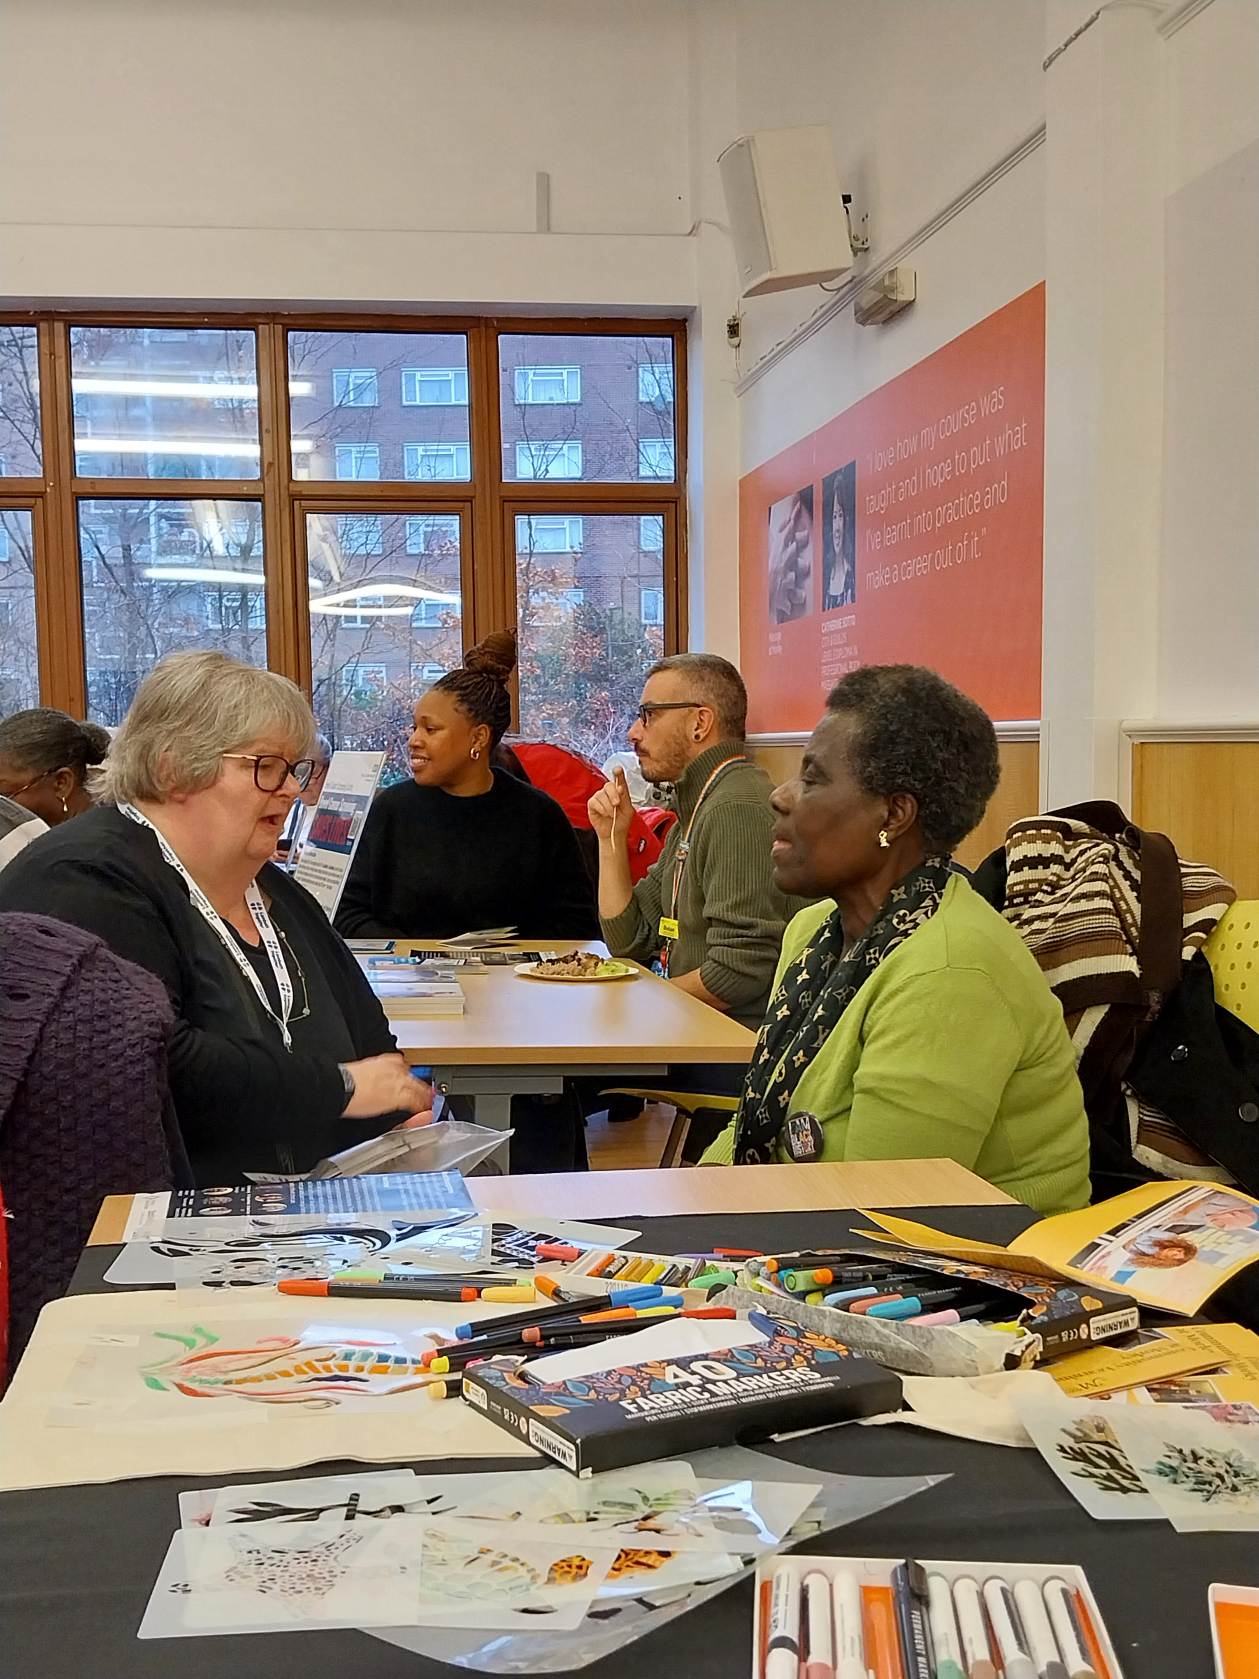
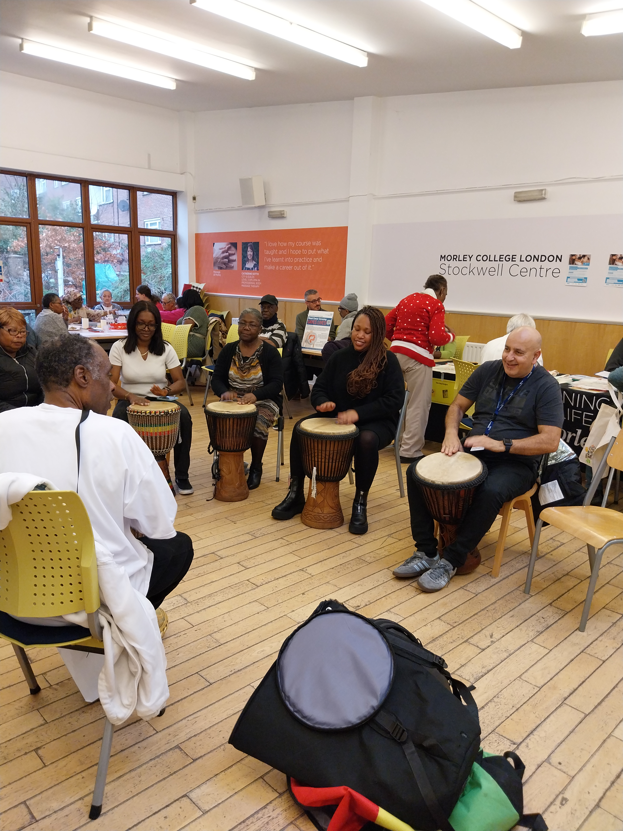
Board on the Bus Listening in our Communities

Slide 2
Board on the Bus: out in the community in December at West Norwood Leisure Centre 12 December 2024 Nozomi Akanuma, Psychiatrist SLAM, Living Well Network Alliance Clinical and Care Professional Lead and Sarah Flanagan, Patient and Public Voice Board Member
Linked in with community organisations present at the event:
Macmillan
Bowel Cancer Screening
Crafts and music activities
PEACS work with those living with chronic pain, particularly women and those from black backgrounds who experience a number of health inequalities, a focus of our Neighbourhood and Wellbeing Delivery Alliance
Spoke with 4 residents
Themes from ‘what matters to you’ postcards:
Better support for managing pain and free exercise training for those experiencing pain
Better suitable council housing
Being heard and understood ‘treating people as individuals not all the same’
Good, timely care

