Slide 1
Lambeth Country Show 2022

Slide 2
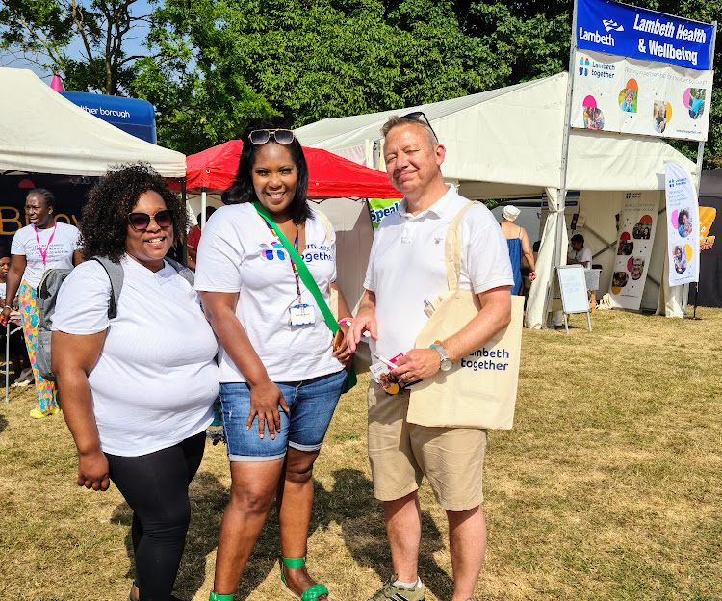

Slide 3
Over 50 volunteers from across LT partners
‘What matters to you?’ postcards – 274 completed
Healthwatch, blood pressure checks, health advice, mental health outreach, smoking
100s of cookbooks for Black communities and information bags

Slide 4
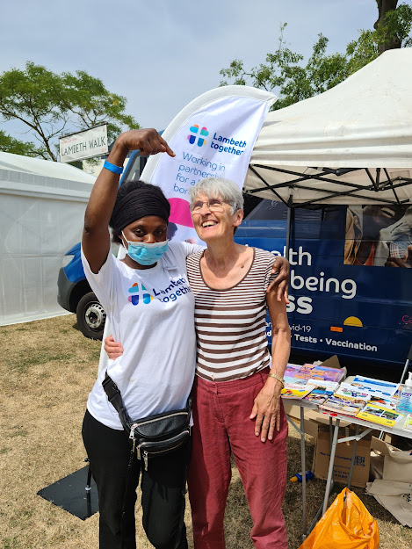
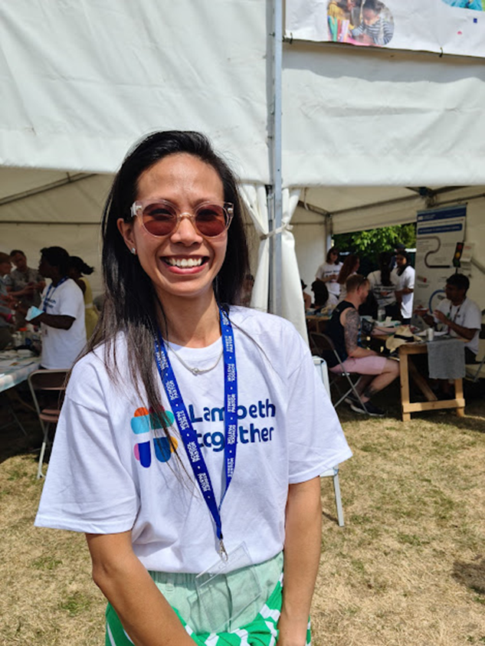
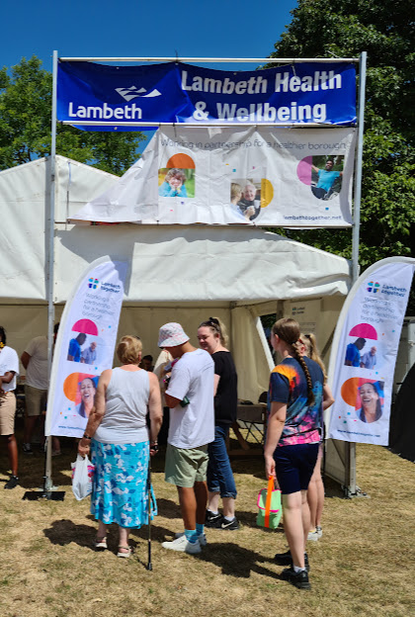

Slide 5
Staff and Board members from across the Lambeth Together partnership were at the Lambeth Country Show in July 2022.
Activities focused on encouraging residents to get their blood pressure checked, as being aware of and in control of your blood pressure is one of the key ways we can prevent stroke, heart attacks, kidney disease and other life-threatening or life-limiting health events. Despite high temperatures, the team carried out over 300 blood pressure checks. 46 people were advised to contact their GP due to high blood pressure readings, and were given the appropriate advice and literature.
Also available was stop smoking support, advice on services available in community pharmacies, mental health support and advice on eye health. Lambeth Together’s Health and Wellbeing Bus team provided information on wider local health and care support and services to residents. Lambeth Healthwatch was also represented.
273 residents filled in postcards to tell us what mattered to them about their health and care and how this could be addressed. Key issues raised related to difficulties accessing services, particularly GPs and A&E; mental health services; and the need for readily accessible information on health and care services and support.
Overwhelmingly, people responded that what most mattered to them was general good health: people want to be and feel fit and well. Suggestions received included building stronger links between health and environment, more information at community events, and having healthcare sessions in libraries. The data will inform Lambeth Together’s Health and Care Plan and the borough’s Health and Wellbeing Strategy. Suggestions and feedback about specific services areas has been shared with the relevant Lambeth Together teams.

